Slide 1

TOPIC-Operating System
COURSE: CCC Concept
CHAPTER: 01 (Operating System)
DAY: 11
NIELIT
Presentation By :Anjali Dhingan

Slide 2
Share printer
Share the printer on the primary PC
There are two ways to share your printer: using Settings or Control Panel. Share your printer using Settings
Select the Start button, then select Settings > Devices > Printers & scanners. Choose the printer you want to share, then select Manage.
Select Printer Properties, then choose the Sharing tab. On the Sharing tab, select Share this printer.
If you want, edit the share name of the printer. You'll use this name to connect to the printer from a secondary PC.
Share your printer using Control Panel
In the search box on the taskbar, type control panel and then select Control Panel.
Under Hardware and Sound, select View devices and printers.
Select and hold (or right-click) the printer you want to share, select Printer properties, and then choose the Sharing tab.
On the Sharing tab, select Share this printer.
If you want, edit the share name of the printer. You'll use this name to connect to
the printer from a secondary PC.

Slide 3
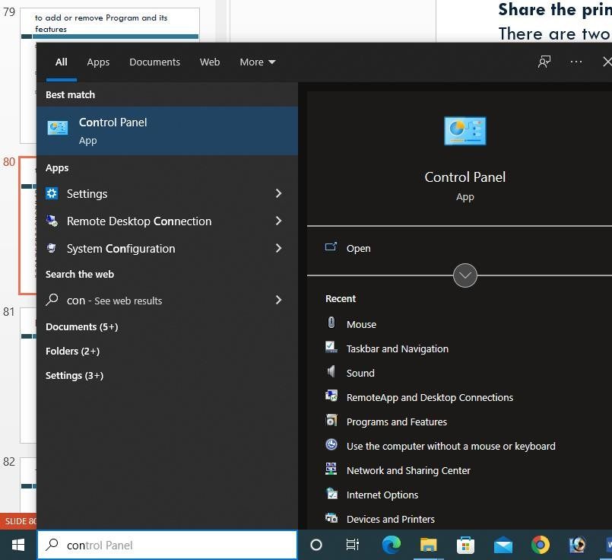
Type con in Search Box

Slide 4
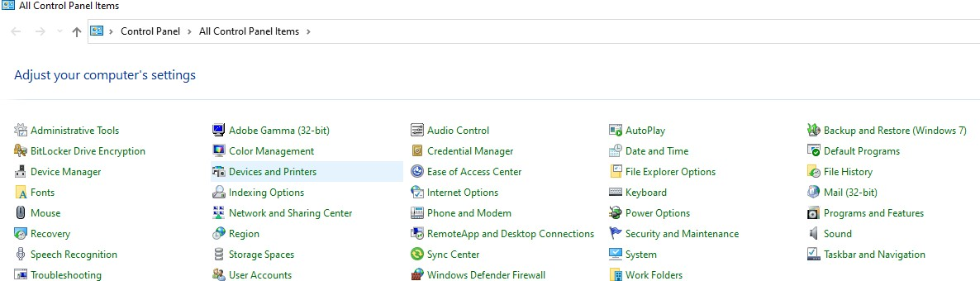

Click Devices and Printers

Slide 5
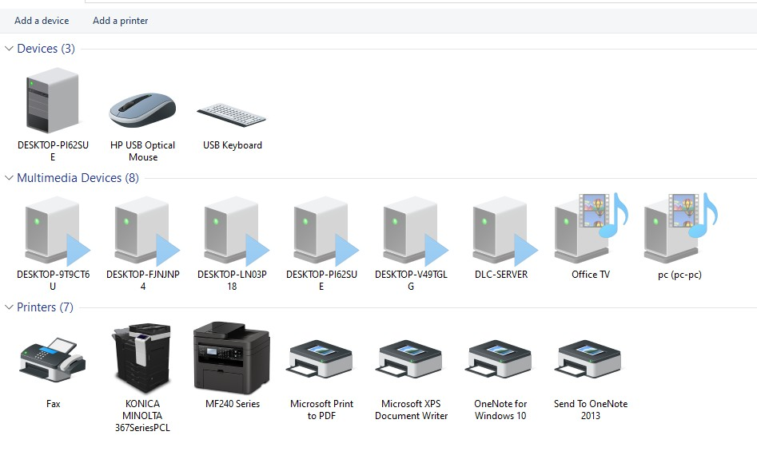

Slide 6
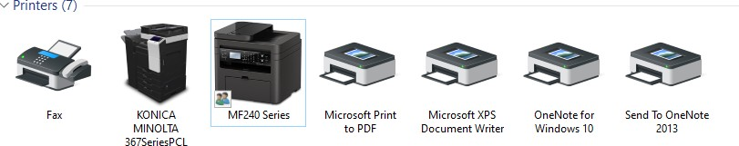


Slide 7
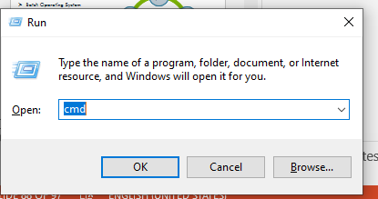
Press windows key + R
Type CMD
OK

Slide 8
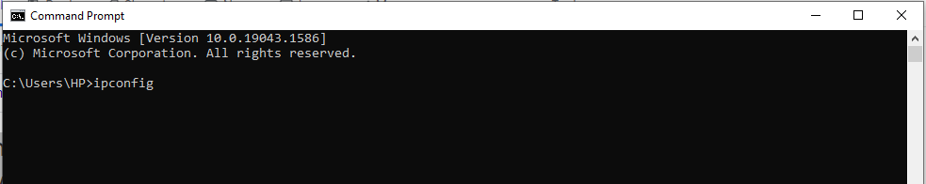
Press windows key + R
Type ipconfig for finding computer IT adress
Enter

Slide 9
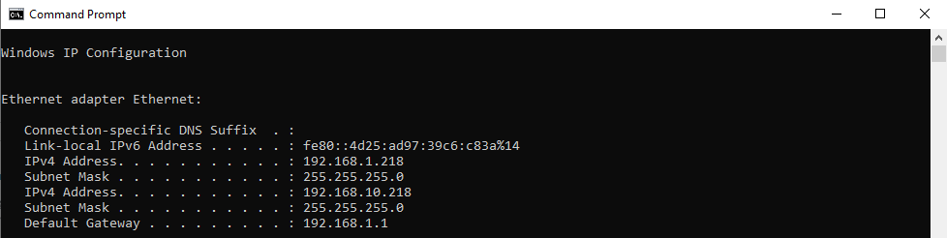

Note down the IP

Slide 10
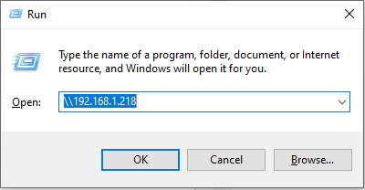
Go different pc
Press windows key + R
Type IP address with back slash
ok

Slide 11
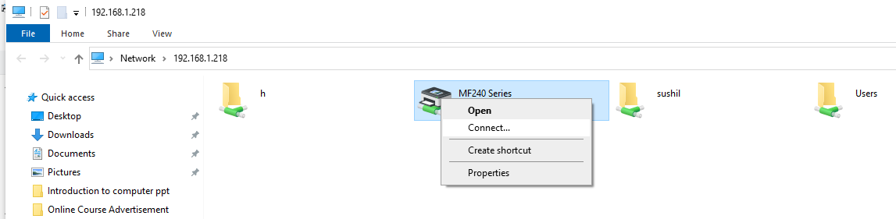
Right Click on printer driver

Slide 12
File and Folder management
A file management system is used for file maintenance (or management) operations. It is is a type of software that manages data files in a computer system. A file management system has limited capabilities and is designed to manage individual or group files, such as special office documents and records

Slide 13
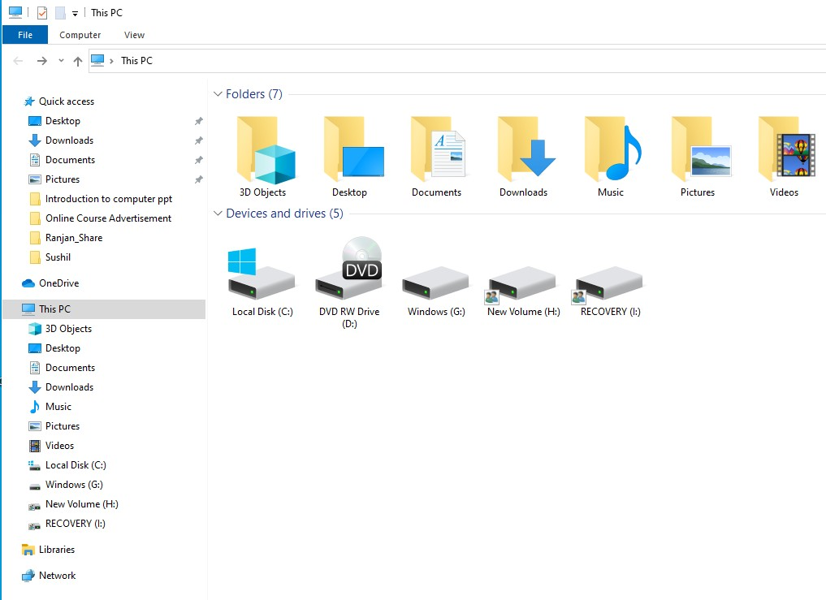
File Explorer in Win-10

Slide 14
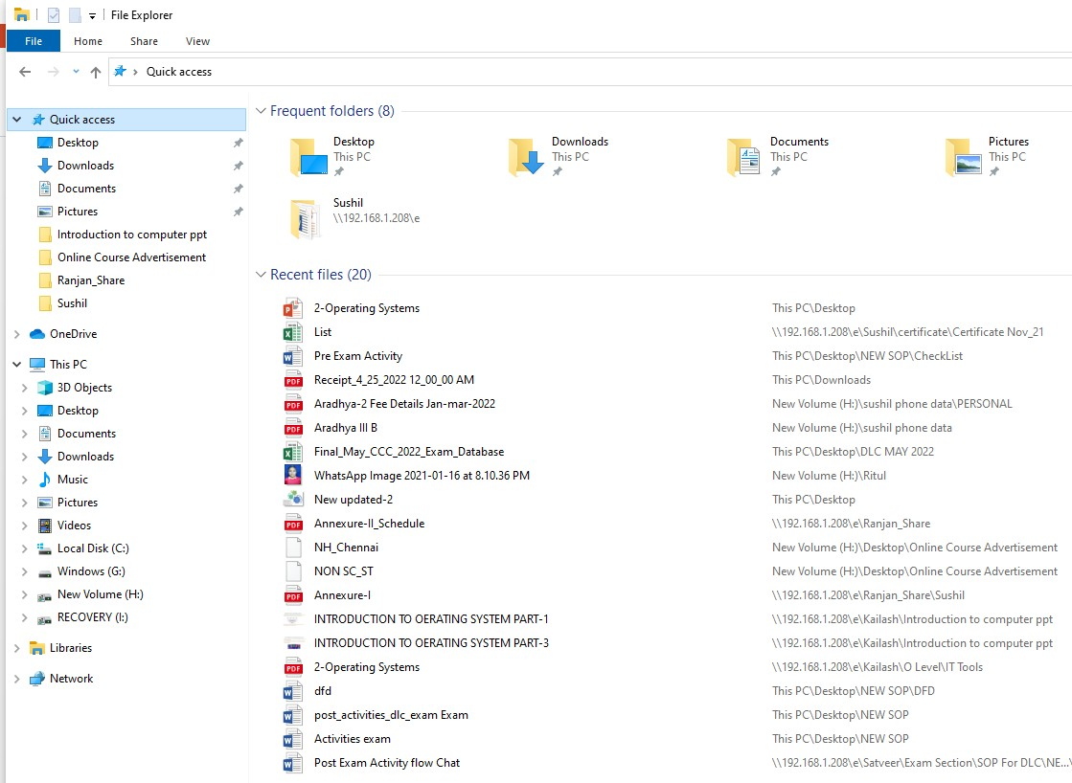
File Explorer in Win-10

Slide 15
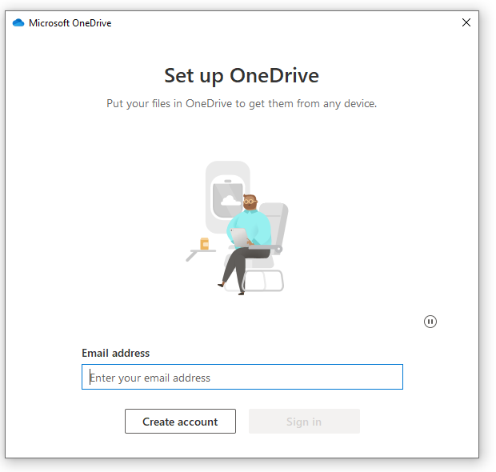
One Drive

Slide 16
Library
Libraries are virtual containers for users' content. A library can contain files and folders stored on the local computer or in a remote storage location. In Windows Explorer, users interact with libraries in ways similar to how they would interact with other folders.

Slide 17
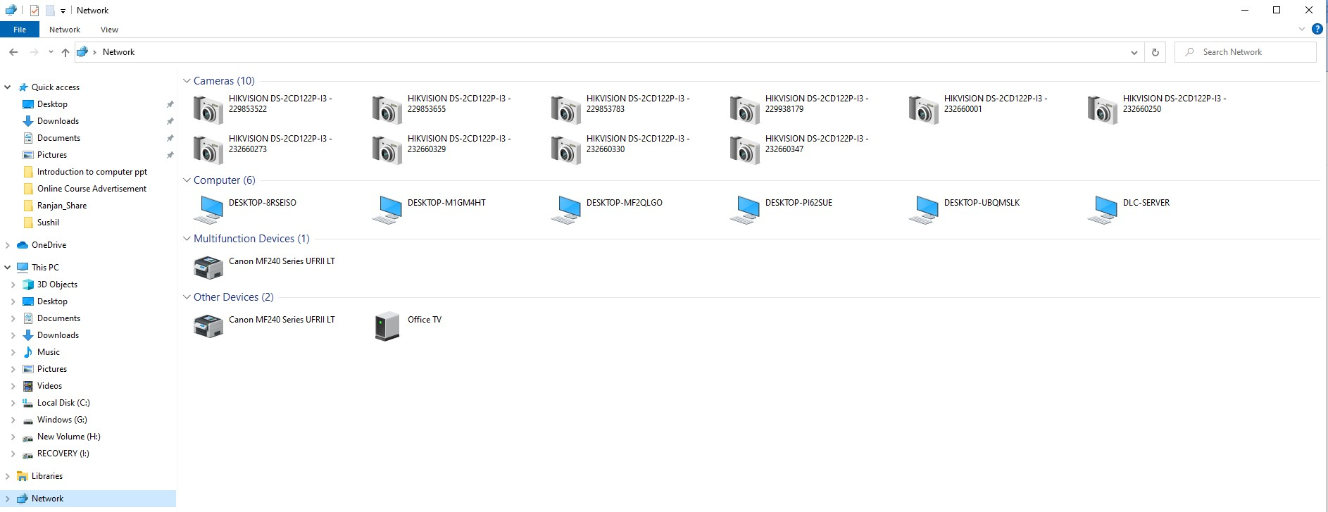
Network

Slide 18
TYPES OF OPERATING SYSTEM
Batch Operating System
Time-Sharing Operating System
Distributed Operating System
Network Operating System
Real-Time Operating System

Slide 19
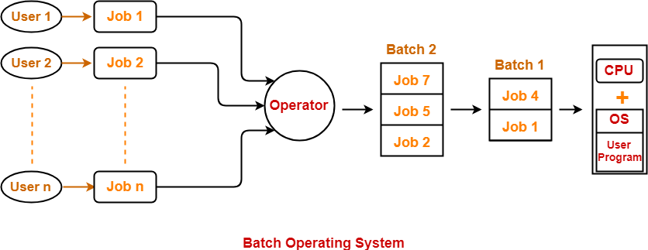
Batch Operating System:-
In a Batch Operating System, the similar jobs are grouped together into batches with the help of some operator and these batches are executed one by one.
This type of operating system does not interact with the computer directly. There is an operator which takes similar jobs having the same requirement and group them into batches. It is the responsibility of the operator to sort jobs with similar needs.

Slide 20
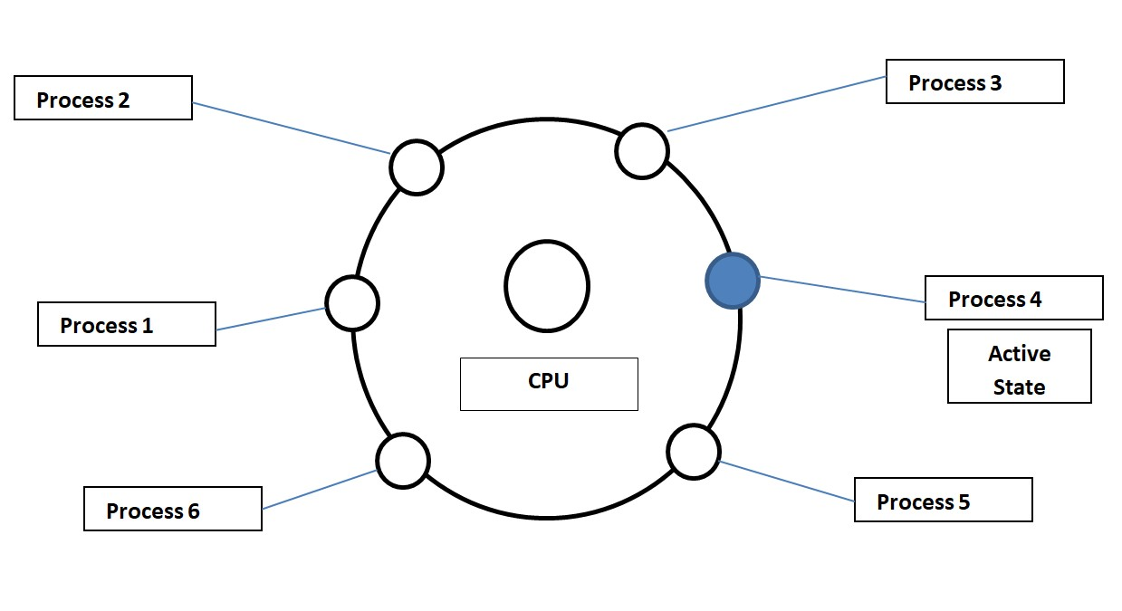
Time-Sharing Operating System:-
In Time-Sharing Operating System Each task is given some time to execute so that
all the tasks work smoothly.
Each user gets the time of CPU as they use a single system.
These systems are also known as Multitasking Systems. The task can be from a
single user or different users also.

Slide 21
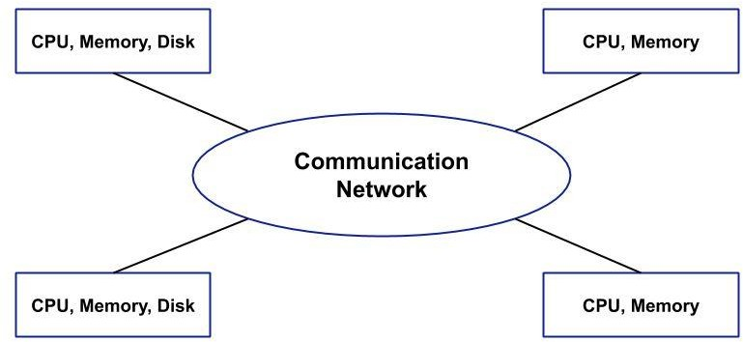
Distributed Operating System:-
In a Distributed Operating System, we have various systems and all these system have their own CPU, main memory, secondary memory, and resources.
These systems are connected to each other using a shared communication network. Here, each system can perform its task individually.

Slide 22
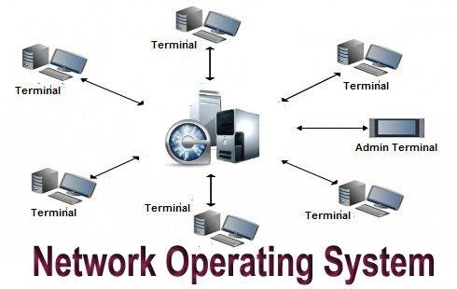
Network Operating System:-
These systems run on a server and provide the capability to manage data, groups, security, applications, and other networking functions.
These types of operating systems allow shared access of files, printers, security,
applications, and other networking functions over a small private network.

Slide 23
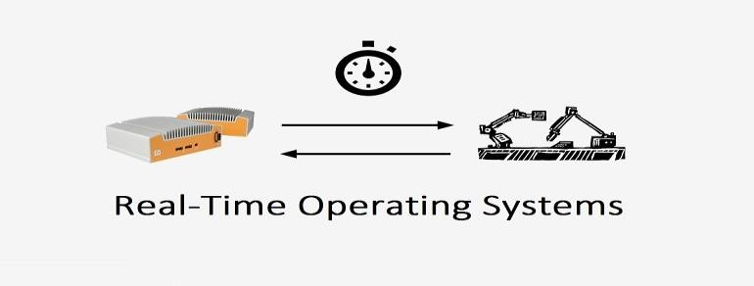
Real-Time Operating System:-
In Real Time Operating Systems, each job carries a certain deadline within which the Job is supposed to be completed, otherwise the huge loss will be there or even if the result is produced then it will be completely useless.
There are two types of Real-Time Operating System
Hard Real-Time Operating Systems
Soft Real-Time Operating Systems
Firm Real-Time Operating Systems

Slide 24
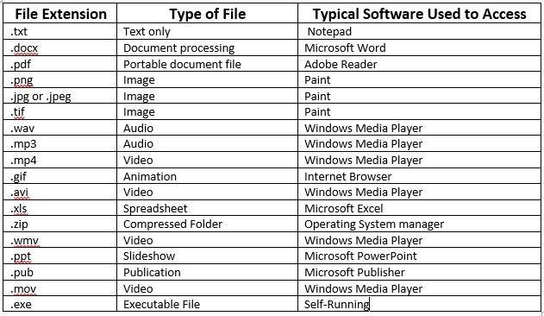
File Extension

Slide 25
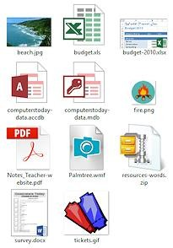
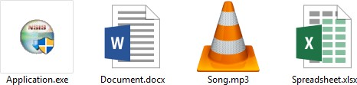
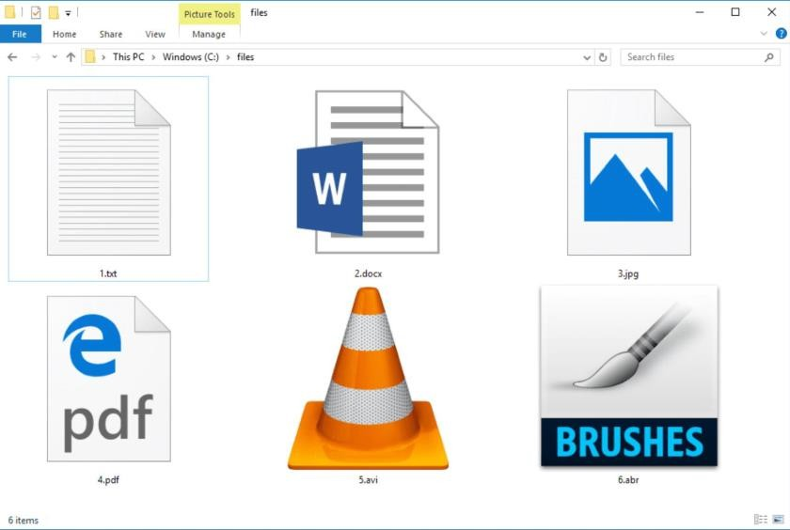

Slide 26
Thank You
NIELIT

